Slide 1

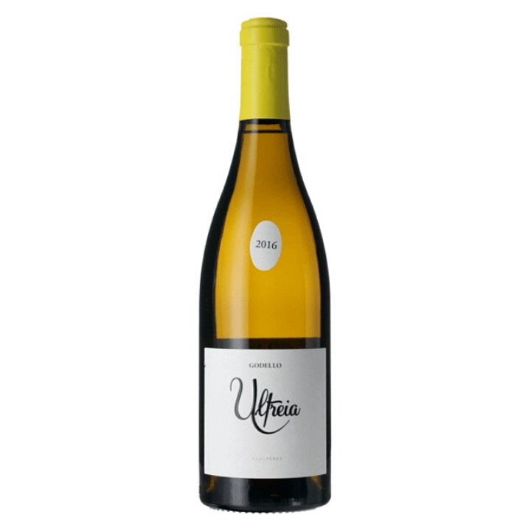

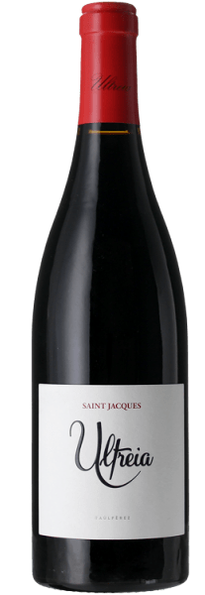

Special Wines from Spain
Raul Perez -
Ultreia Godello 2018
Ultreia Saint Jacques 2017

Slide 2
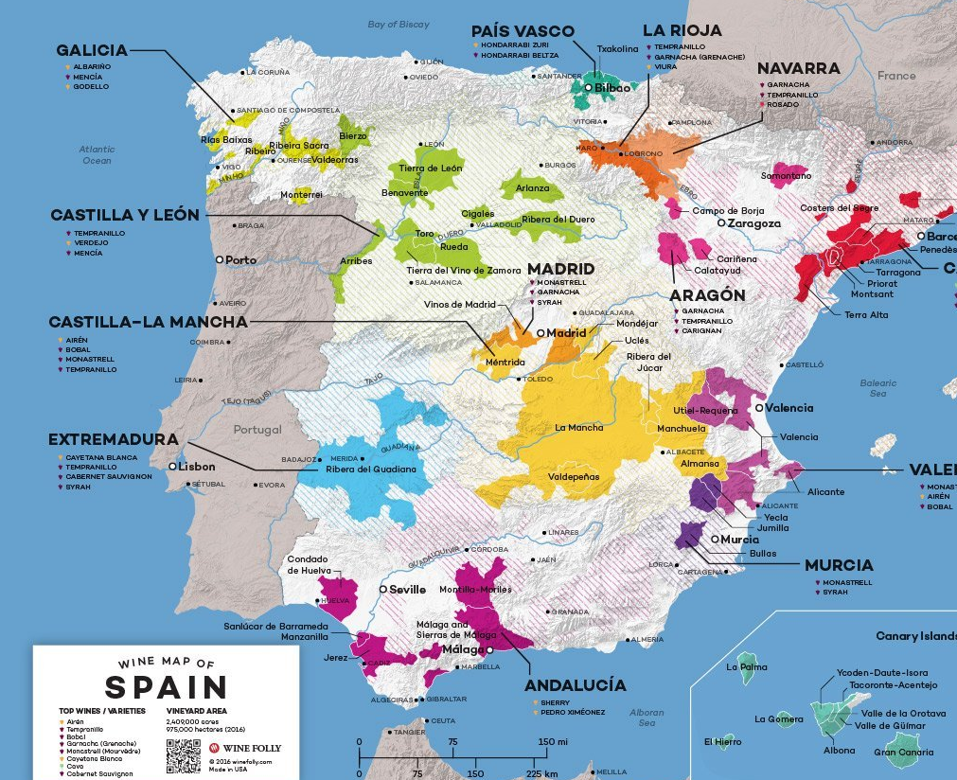

Slide 3
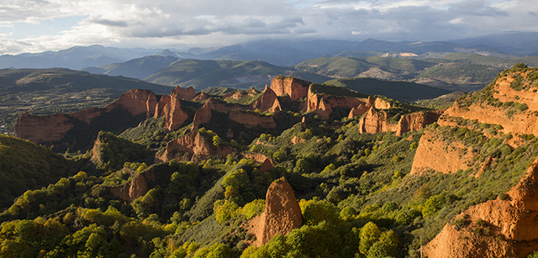

Background
Rich history – pilgrims, Celtic roots.
Atlantic influence, mountain ranges
Bedrock, old vines
Bierzo Alto / Bierzo Bajo

Slide 4
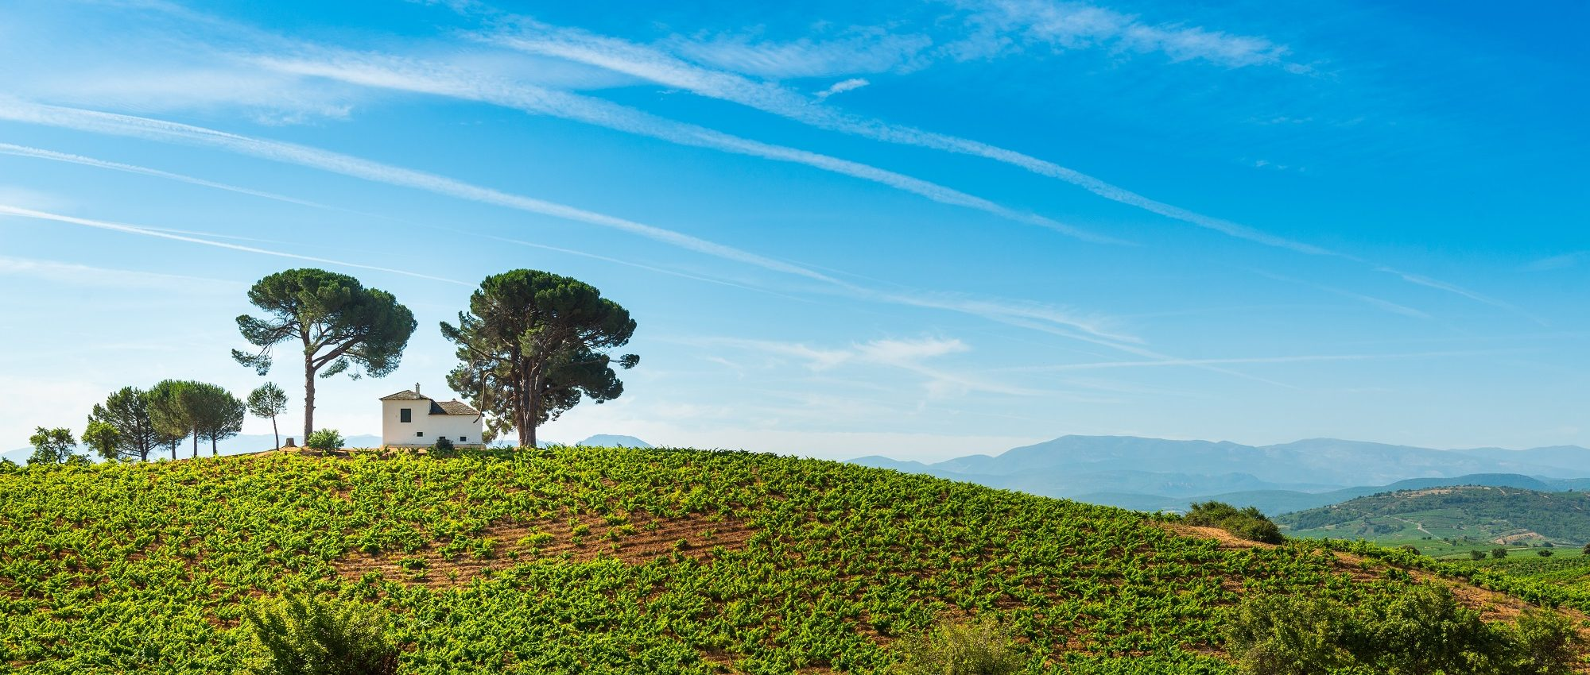
The Rise of Bierzo
Unknown up until 1990’s
Investment & Innovation
DO status 1989
Today - 80 bodegas

Slide 5
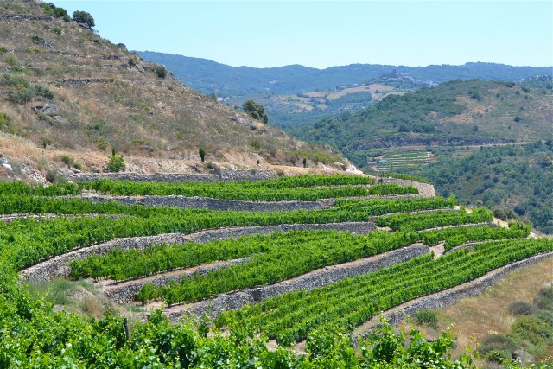

Slide 6
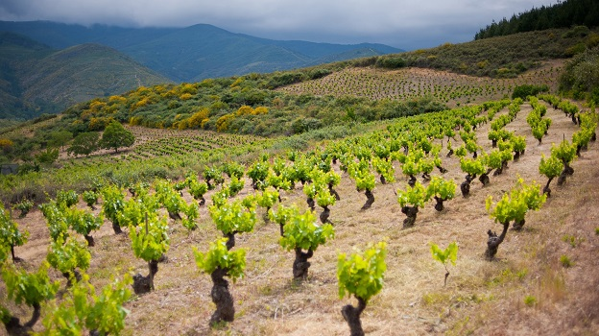
Grape Varieties
Wines light, dry, refreshing
Dominated by white wines
White: Dona Blanca, Godello, Malvasia, Palomino
Red: Mencía, Garnacha (blends)

Slide 7
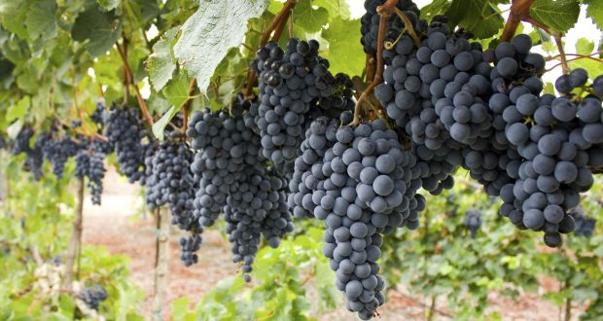
Mencía
Two-thirds of vineyards
Spectrum of styles
Red fruit
Smoky flavours from meat
Gastronomic

Slide 8
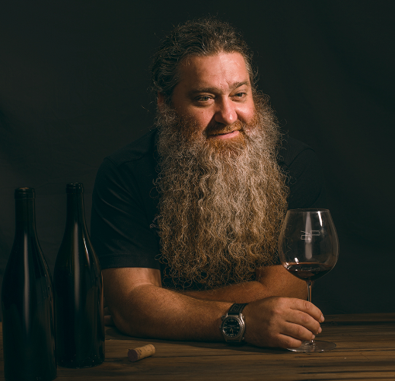
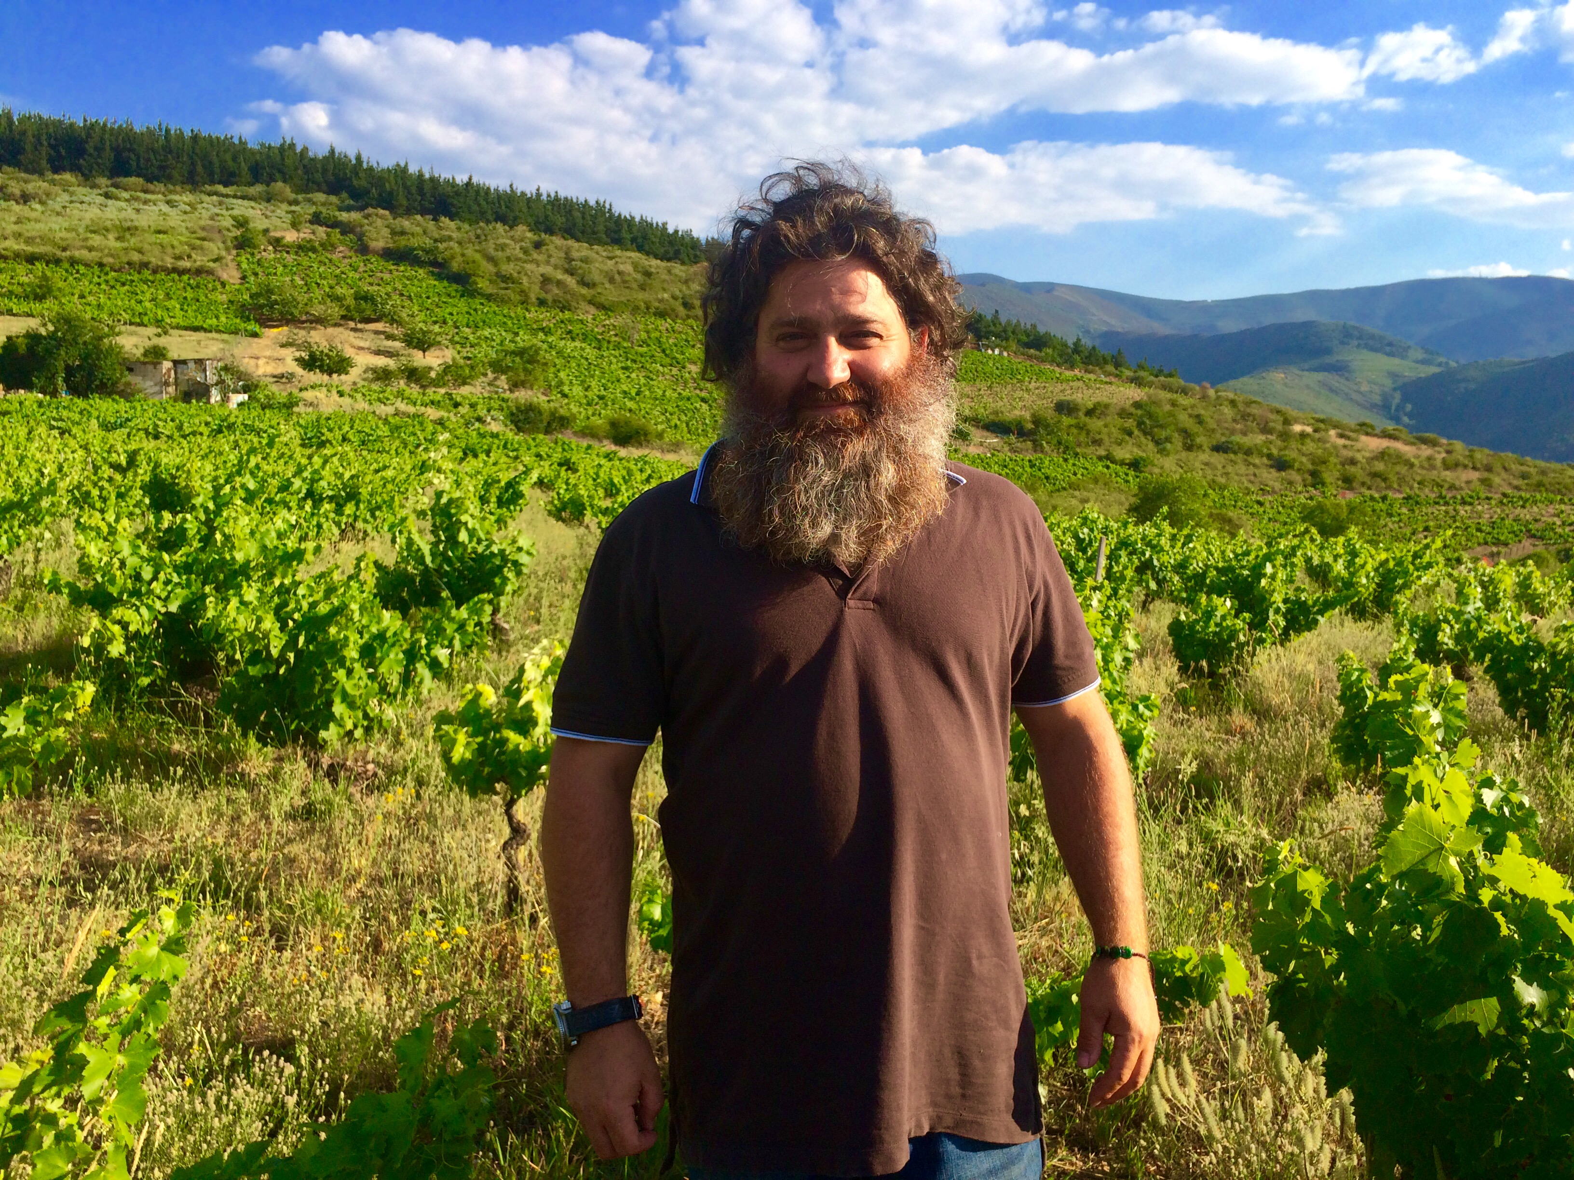
Producer Profile: Raul Perez
Began 1994 – family winery
First personal project 2003 – Ultreia
Winemaking wizard
Open door policy
Minimum influence on grapes
Non-standardised wines

Slide 9
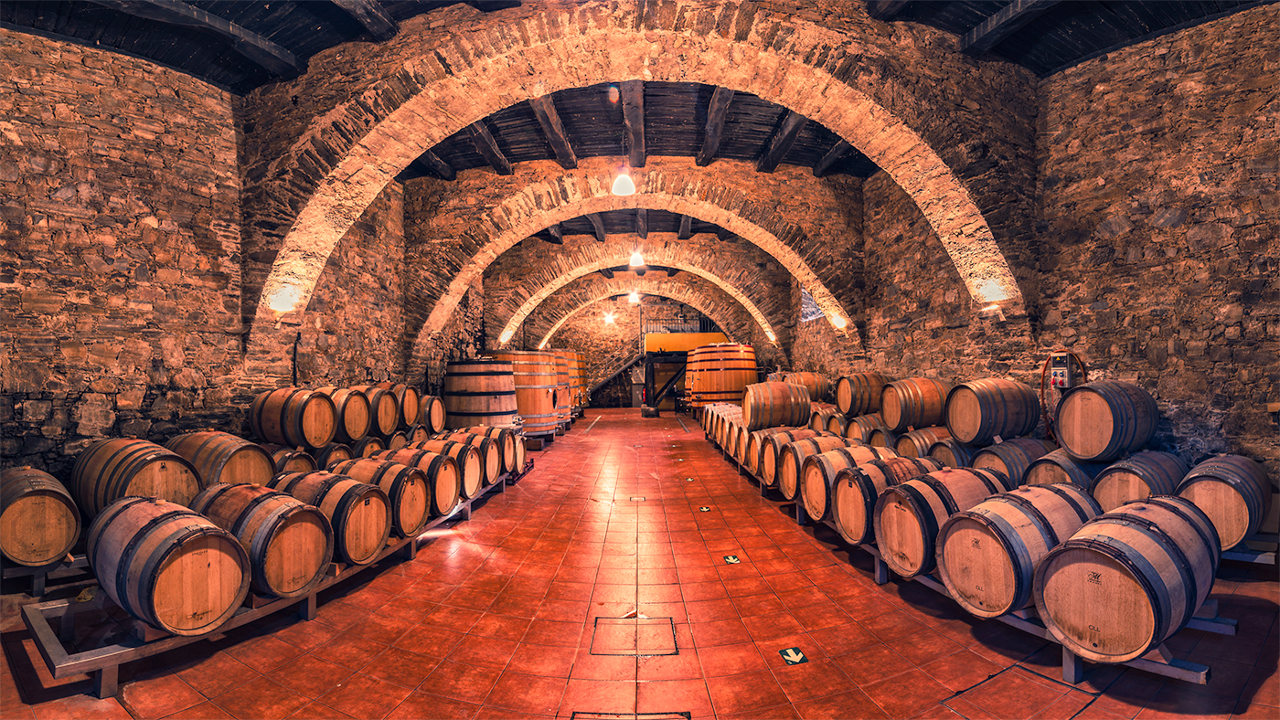

Slide 10
Raul Perez - Ultreia Godello 2018
Grape: 100% Godello
Winemaking: Aged for 12 months in oak barrels
Price Point: £20.95

Slide 11
Raul Perez - Ultreia Godello 2018
Colour: Yellow with golden reflections
Nose: Honey, Yellow plum, Citrus, Blossom, Fennel, Aniseed
Palate: Soft, Open, Fine acidity, Juicy
Food Matches: Fish, Shellfish, White Meat, Cheeses

Slide 12
Raul Perez - Ultreia Saint Jacques 2017
Grape: 100% Mencia
Winemaking: Aged in oak barrels for 12 months
Price Point: £14.50

Slide 13
Raul Perez - Ultreia Saint Jacques 2017
Colour: Ruby red
Nose: Winter Berries, Raspberry, Violet, Fresh Herbs, Cocoa, Coffee
Palate: Exuberant, Balanced, Textured
Finish: Long, Smooth
Food Matches: Red meat, spicy dishes, strong cheese

Slide 14
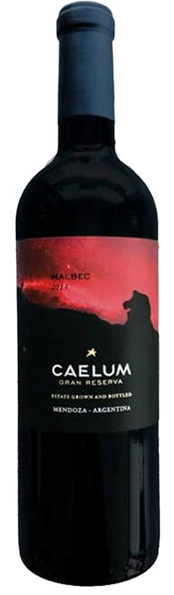
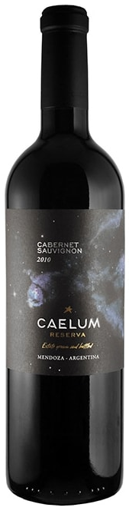
Next Tasting…
A trip to Mendoza!

